Slide 1
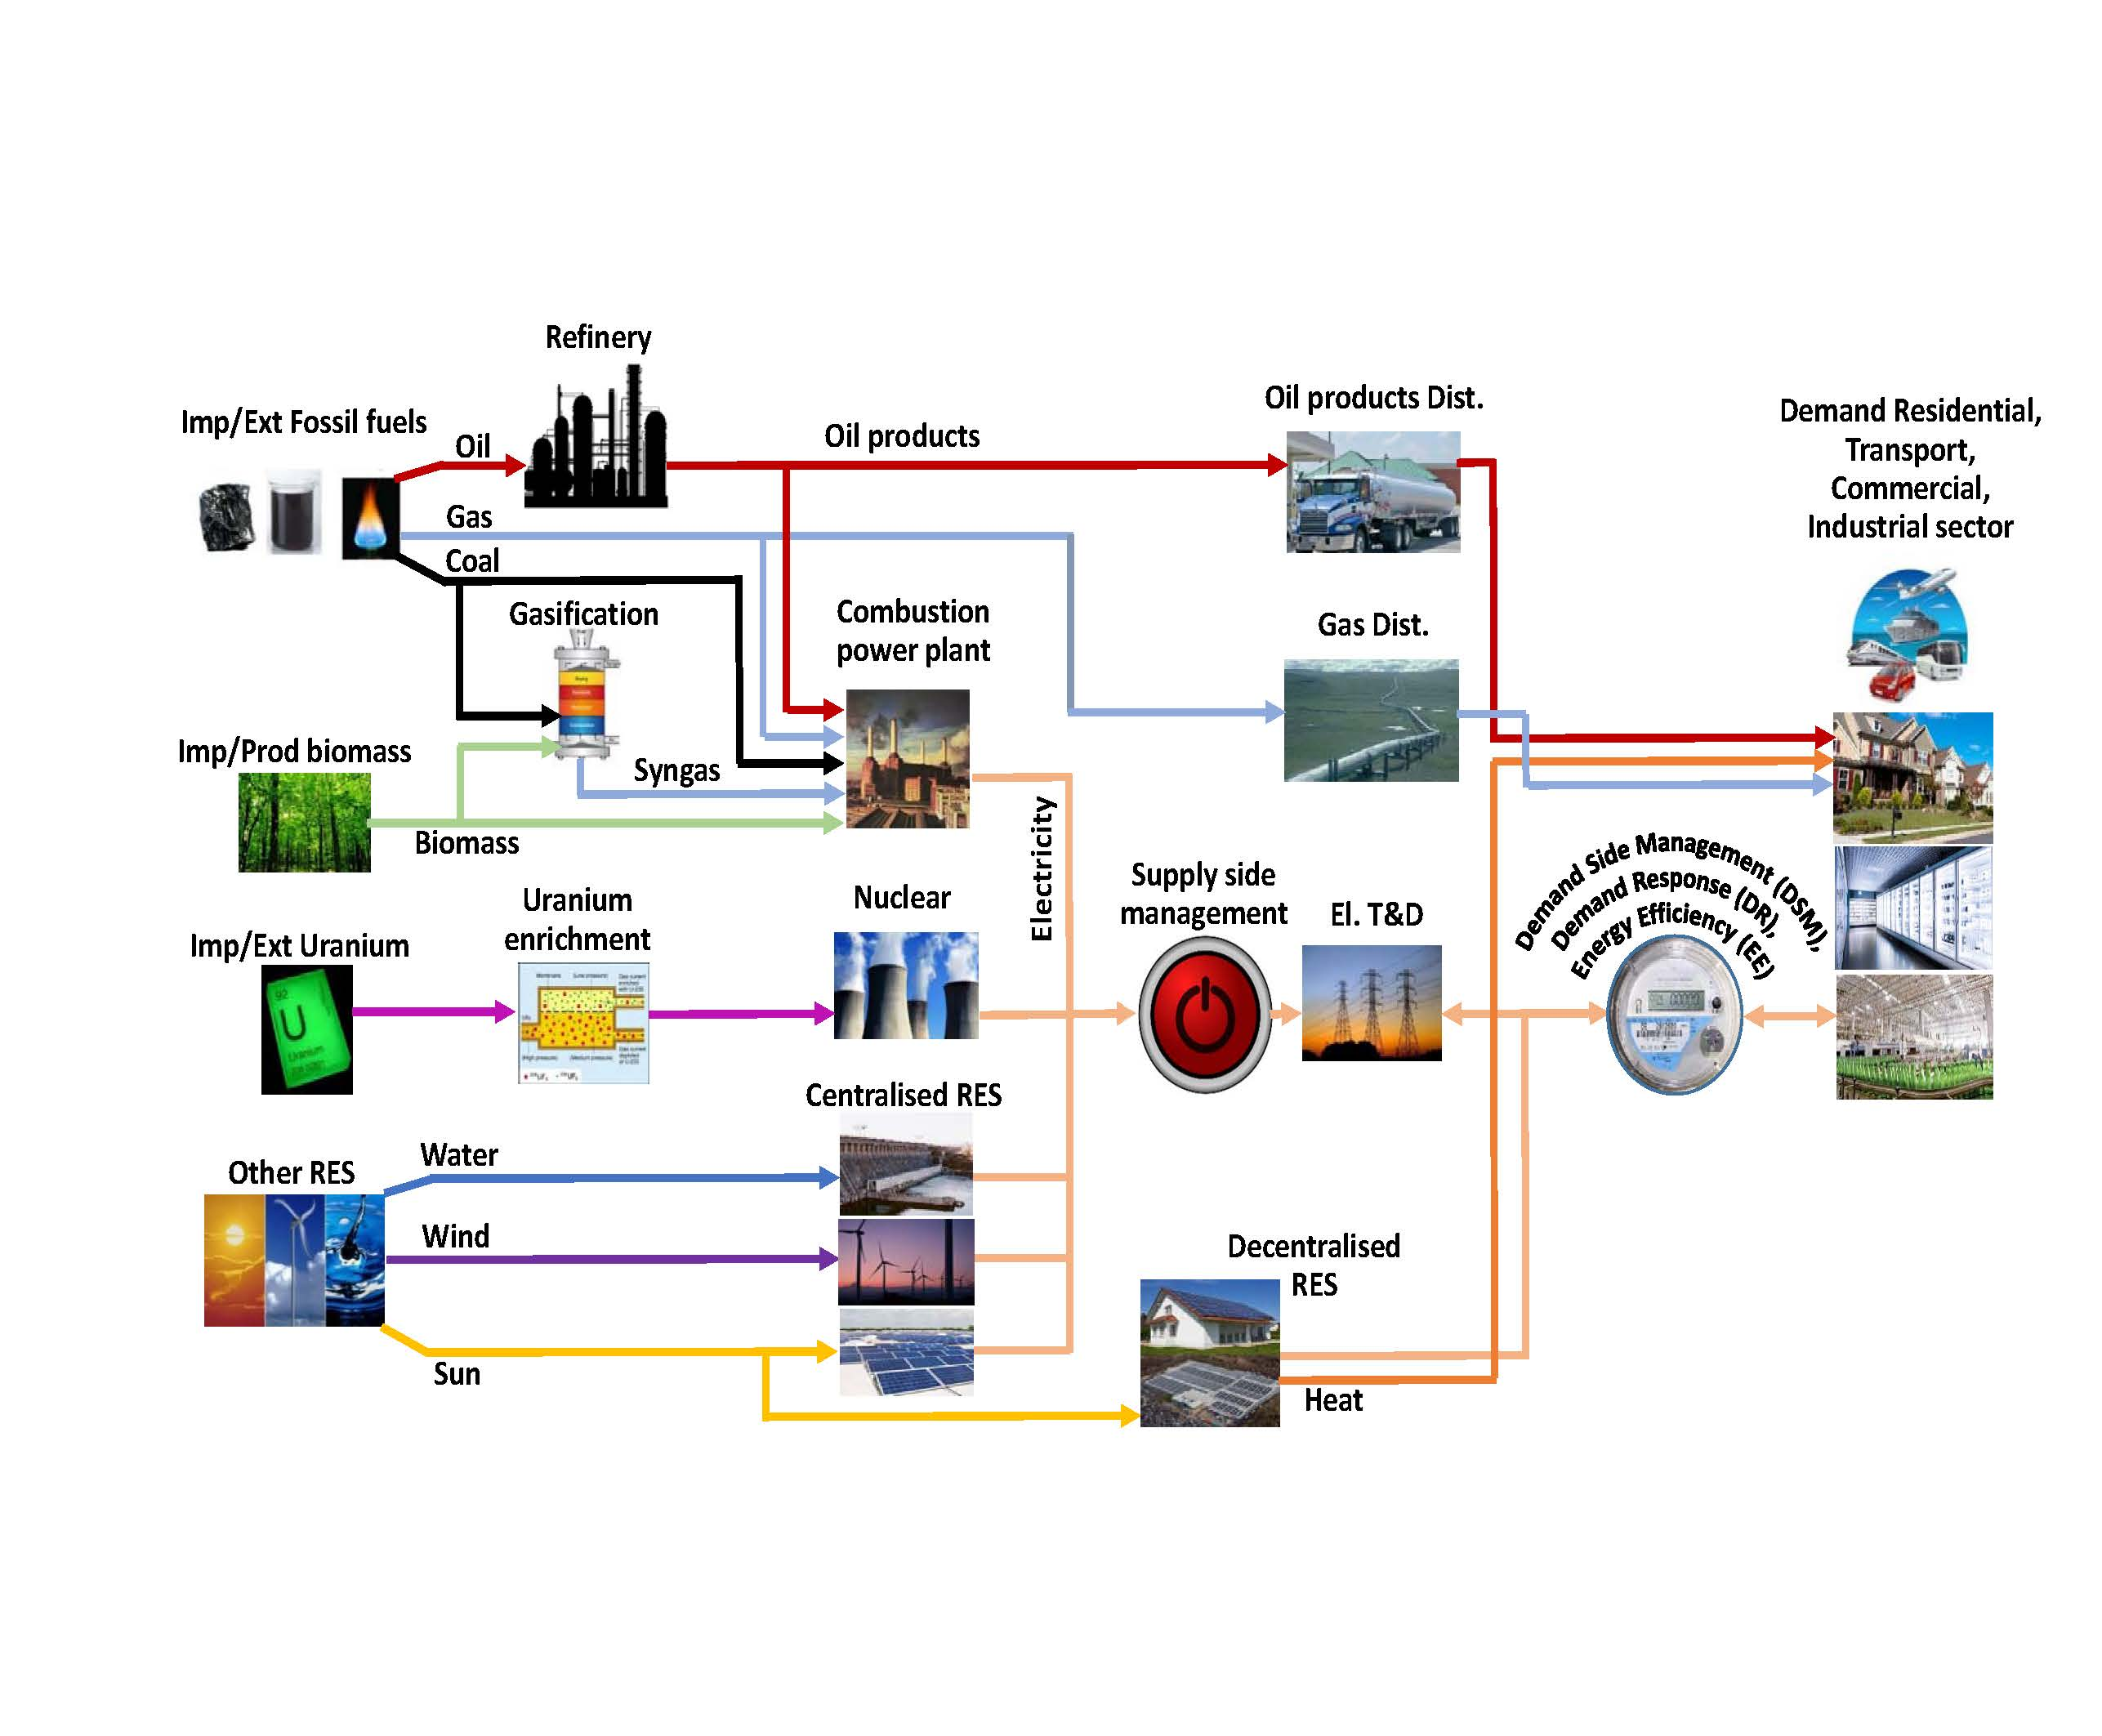
From reality to a model
The complexity of the energy system can be simplified and represented in an organised model structure.
Resources
Primary
Secondary
Final

Slide 2
Why model?

Slide 3
Why model?
Explain (very distinct from predict)
Guide data collection
Illuminate core dynamics
Suggest dynamical analogies
Discover new questions
Promote a scientific habit of mind
Bound (bracket) outcomes to plausible ranges
Illuminate core uncertainties.
Offer crisis options in near-real time
Demonstrate tradeoffs / suggest efficiencies
Challenge the robustness of prevailing theory through perturbations
Expose prevailing wisdom as incompatible with available data
Train practitioners
Discipline the policy dialogue
Educate the general public
Reveal the apparently simple (complex) to be complex (simple)

Slide 4
Why model?
To summarise…
Modelling for INSIGHTS, not numbers… (nor answers)
Huntington et al. (1982)

Slide 5
Modelling insights
Governments/public have qualitative ideas on the future development of the country and its energy system, for example:
Policy goals (e.g. economic development, financial constraints, environmental constraints, energy security, rural development…)
Preferred technology options (e.g. using domestic resources, increasing RES shares…)
Future availability and prices of energy forms…
Public perception: may prefer some technologies over others
Energy systems models provide frameworks to quantitatively assess implications of different energy policy / development options on the energy supply system

Slide 6
Modelling insights
They cannot predict the future
But can help understand future better and stay prepared to take informed decision
They cannot make decisions
The main task of an energy analyst is to evaluate different options and provide clear inputs for decision makers

Slide 7
Modelling is not everything…
Are we really finished when we have got the insights?

Slide 8
Modelling is not everything…
Are we really finished when we have got the insights?
Refine the inputs and analyses involving stakeholders
Make analysis reproducible and build a solid body of research infrastructure
Communicate the results to policy makers
Communicate the results to the civil society
Keep it always transparent, reproducible and sustainable!

